Slide 1
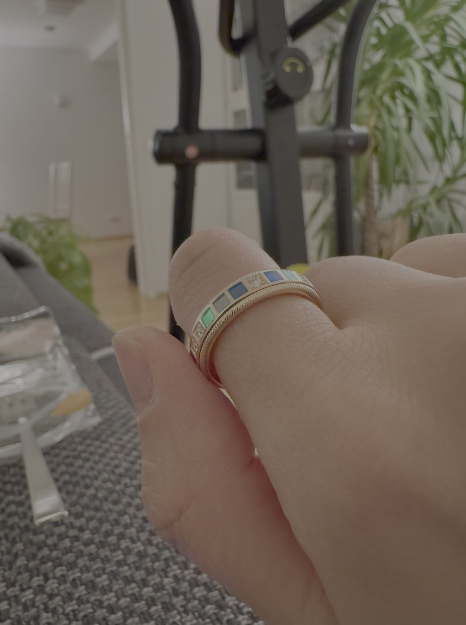
Cible
AI On Your Finger
A ring that thinks. Jewelry first, AI second.

Slide 2
How Cible Works
Twist to record. AI takes action.
1
Personal Encyclopedia
Ask anything, anytime. Bring curiosity back to life—from 'Why is California's sky so blue?' to any spontaneous question.
2
AI To-Do List
Turn one sentence into actionable steps. Just say 'I want to study,' and AI breaks it down—breathe, focus, start. Complete each step, twist the ring, watch the gem light turn green.
3
Emotion & Life Journal
What you did, cared about, and felt—AI turns your day into reflective insights. Not just pretty notes, but meaningful growth tracking.
A ring that's beautiful to wear. An AI that helps you learn, act, and reflect.

